Slide 1
Machine Learning in Practice I
Lecture 2
Antal Jakovac, 2025

Slide 2
Logics of Intelligence

Slide 3


Logics of Intelligence
Consider a world W consisting of 2 pixels
{ , , , … }
W also has two visible states A and B. We observe that
  A → { , ,… }
  B → { , ,… }
Step1: problem definition: tell the state from the pixels
→ classification task

Slide 4
Logics of Intelligence
Step2-3: Data collection, cleaning, preprocessing
in our case: observation → numerics
the pixels are black-and-white → brightness is a number in [0,1]
  black: 0
  white: 1
  grey: somewhere in between
2 pixels mean 2 numbers
usually Step2-3 is rather tedious…

Slide 5
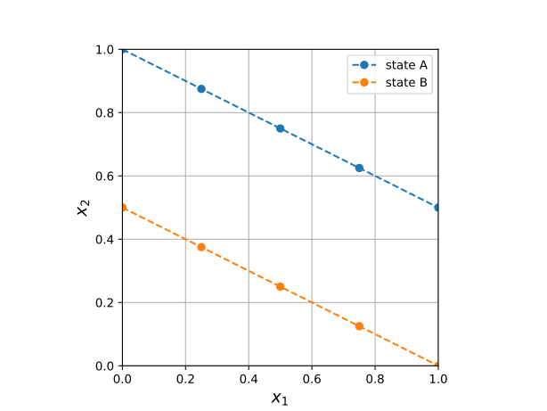
Logics of Intelligence
Step4-5-6: feature engineering, model selection, training
(in practice these are separate steps)
Let us plot the point pairs corresponding to state A and B
  the points lie in subspaces (lines)
  within state A and B
  worth to introduce new coordinates (features)

Slide 6
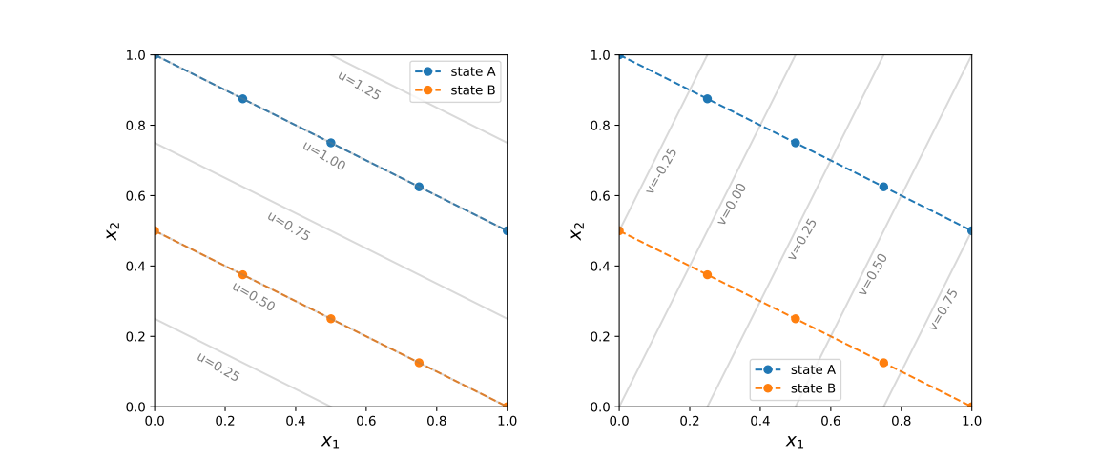

Logics of Intelligence
Step4-5-6: feature engineering, model selection, training
with the new coordinates
constant u – aligned with states; constant v – changes within a given state

Slide 7

Logics of Intelligence
Step4-5-6: feature engineering, model selection, training
To tell apart state A and B we need only the value of u!
  u = 1.0 state A
  u = 0.5 state B
  otherwise neither
solves classification task

Slide 8
Logics of Intelligence
Step4-5-6: feature engineering, model selection, training
To describe a instance belonging to a state we need just v!
  state A: v in [-0.5,0.75]
  state B: v in [-0.25,1]
solves compression,
dimensional reduction

Slide 9
Logics of Intelligence
Step4-5-6: feature engineering, model selection, training
a perfect feature selection provides a coordinate system best aligned with the equivalence classes of the data
  there are coordinates that are constant on each data class, and have different values on different classes (relevant/selective coordinates – good for classification)
  there are coordinates that change within a given data class (descriptive/irrelevant coordinates – good for compression)
task of all model building is to find (approximately) these coordinates/features

Slide 10
Logics of Intelligence
Step4-5-6: feature engineering, model selection, training
in practice we separate the task of coordination
  feature selection: original features, simple combinations
  model selection: single out a parametrizable functional space to combine the features (distance, linear- or nonlinear combinations)
  training: determine the free parameters of the model that fits the data the best

Slide 11
Logics of Intelligence
Step4-5-6: feature engineering, model selection, training
mind vs data?
  data/models importance ratio → data are central importance in real world applications
  are data enough? do we possess the necessary knowledge?
  present approach: data engineering is the most important, few fundamental research (cf. LeCun vs Wang in Meta)

Slide 12
Logics of Intelligence
Step7: evaluation
try to estimate how well the original task was solved
  class reconstruction accuracy
  robustness, proclivity for failures
  treatment of outliers
  business benefits

Slide 13
Logics of Intelligence
Step8: deployment and monitoring
in a real-life application the ML code is used as a product
requires continuous monitoring
  data/environment may change
  new classes appear
  errors may occur

Slide 14
Logics of Intelligence
takehome message: Task of the intelligence is to
find the relevant features and adapt their values to the task

Slide 15
Organizing ML projects

Slide 16
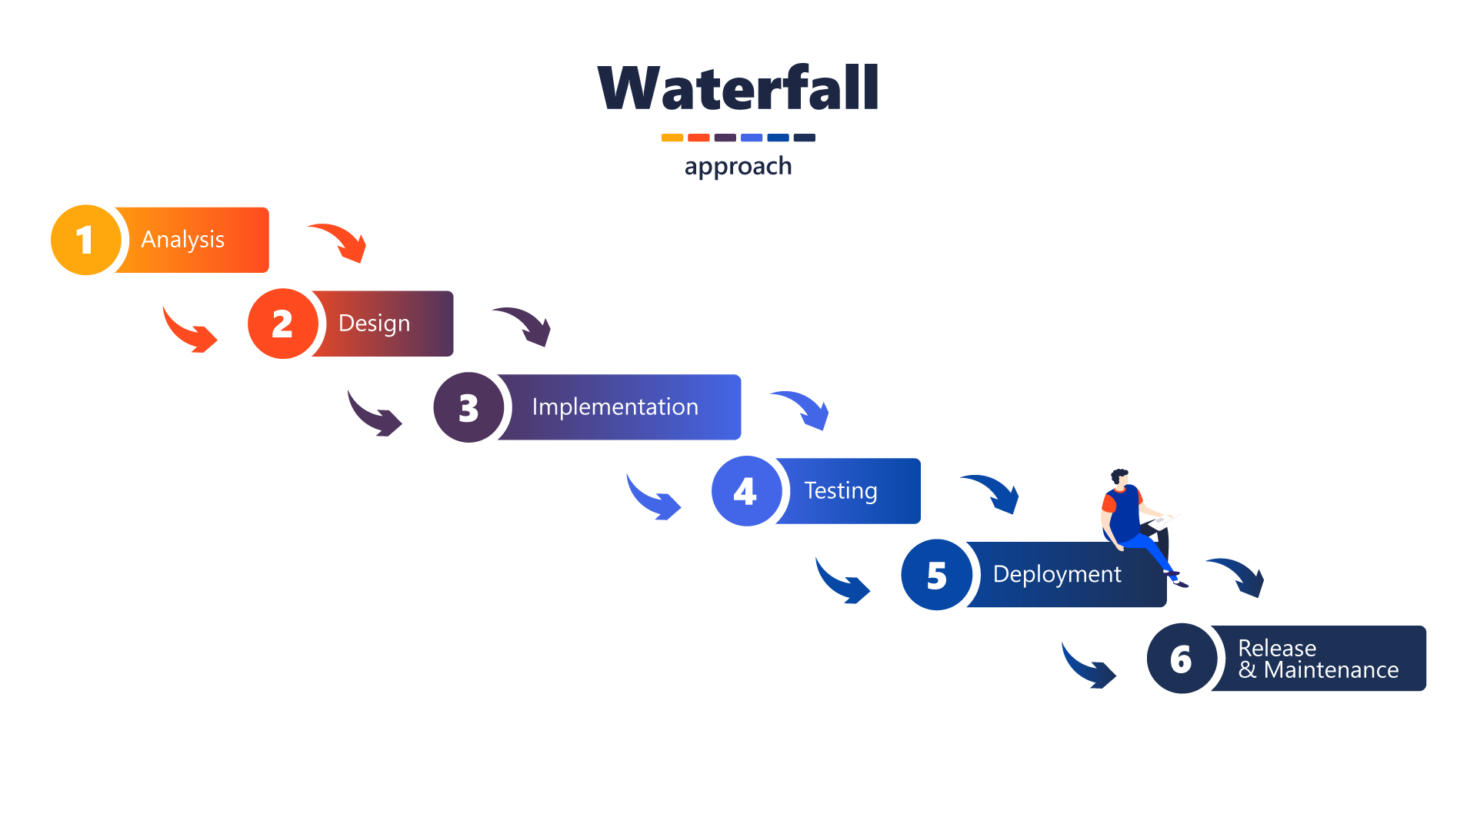
Organizing ML projects
two popular workflow schemes today: waterfall vs. agile
waterfall workflow:
  clear documentation of the task
  predictable timeline
  inflexible
  late discovery of errors
good for well-defined projects (like bridge building)

Slide 17
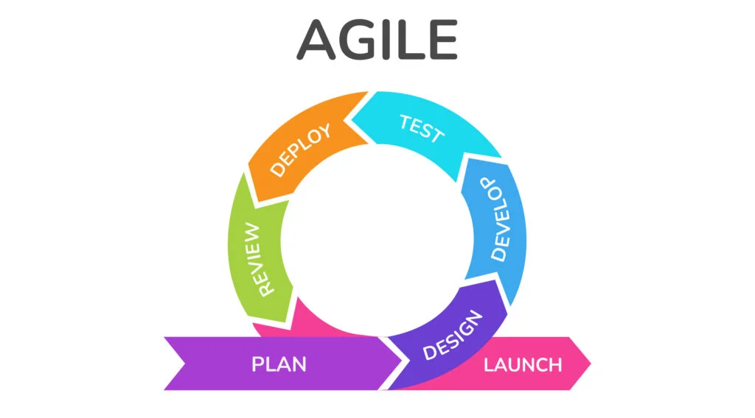


Organizing ML projects
agile workflow: (agile manifesto, description)
  individuals > processes
    collaborative vs rigid teams
  working model > detailed documentation
    Minimal Viable Product MVP
    improvement
“If you’re not embarrassed by the first version of
your product, you’ve launched too late.”
— Reid Hoffman, founder of LinkedIn
Goal: Solve transportation
MVP: Skateboard
Next: Bicycle
Then: Motorcycle
Finally: Car

Slide 18
Organizing ML projects
agile workflow: (agile manifesto, description)
  customer collaboration > contract negotiation
    customer needs even over signed contracts
  responding to change > following a plan
    original ideas/original task estimates may fail
    continuous adaptation
  launch a “good enough” product

Slide 19
Organizing ML projects
agile workflow: (agile manifesto, description)
  pros:
    flexible, self-improving, communicative
    customer-centric
  cons:
    over-emphasized meetings (“agile theater”)
    over-controlled
    less predictable

Slide 20
Organizing ML projects
agile workflow: (agile manifesto, description)
  loops, sprints
  user interface/user experience (UI/UX)
  CI/CD, CI/CD pipelines
  continuous integration, continuous deployment
  Kanban/Jira: project development visualization
  (backlog, to do, in progress, testing, done)

Slide 21
Organizing ML projects
typical small group agile project
  define the goal (user stories), create a backlog (list of tasks)
  make repo (github), branches
  make MVP, backend API, frontend, testbed
  get MVP working, deploy to test environment
  collect feedback (team + users)
  refine tasks, and directions to proceed

Slide 22
Organizing ML projects
Structure of a professional ML organization
🌐 Business side
  client/stakeholder: business requirements (e.g., “reduce equipment downtime,” “recommend better products”)
  Business Analyst / Product Manager (translates business goals into ML problems, acts as the bridge between client and technical teams)
  Project/ Product Manager (budgeting, timelines, and resource allocation, Coordinates with business analysts and technical leads to estimate cost)

Slide 23

Organizing ML projects
Production level ML organization
🧠 Data/model experts
  data engineer: build and maintain data pipelines → data collection, cleaning, validating, transformation (ETL/ELT), storing (database, data lake), monitoring
  ML engineer/data scientist
    feature generation
    design, train, and fine-tune ML models
    explores and experiments with data, build prototypes
    performance evaluation

Slide 24
Organizing ML projects
Production level ML organization
🏗️ Software & Infrastructure
  software architect: designs overall system, service planning, integration with other services, APIs, databases
  software developer (coder): implements algorithms, frontend-backend
  DevOps/MLOps engineer:
    automates deployment, monitoring, scaling of ML models
    works with Docker, Kubernetes, CI/CD pipelines, cloud platforms.
    ensures the ML system is reproducible, reliable, and easy to maintain.

Slide 25
Organizing ML projects
Production level ML organization
🛡️ Operations, Monitoring & Safety
  QA / Test Engineer: tests software and ML pipelines (unit tests, integration tests, stress tests), ensures reliability before release
  Monitoring & Reliability Engineer: monitors system health after deployment.; tracks data drift, performance degradation, unusual patterns
  Security Engineer: ensures compliance with data privacy, protects against adversarial attacks, model leaks.

Slide 26
Organizing ML projects
🎭 The Full Pipeline in a Story (user story)
Client says: “I need early warnings for dangers in a chemical plant.”
Business Analyst refines: “This means anomaly detection on sensor signals.”
Data Engineer sets up pipelines to collect sensor data.
Data Scientist explores, builds a prototype anomaly detector.
ML Engineer optimizes the model for latency and accuracy.

Slide 27
Organizing ML projects
🎭 The Full Pipeline in a Story (user story)
Software Architect decides how it fits into the production system.
Developers implement the service around the model.
DevOps/MLOps deploys it to the cloud with monitoring.
QA & Monitoring check performance and flag issues.
Security Engineer ensures compliance and robustness.

Slide 28
END OF LECTURE 2

